Slide 1

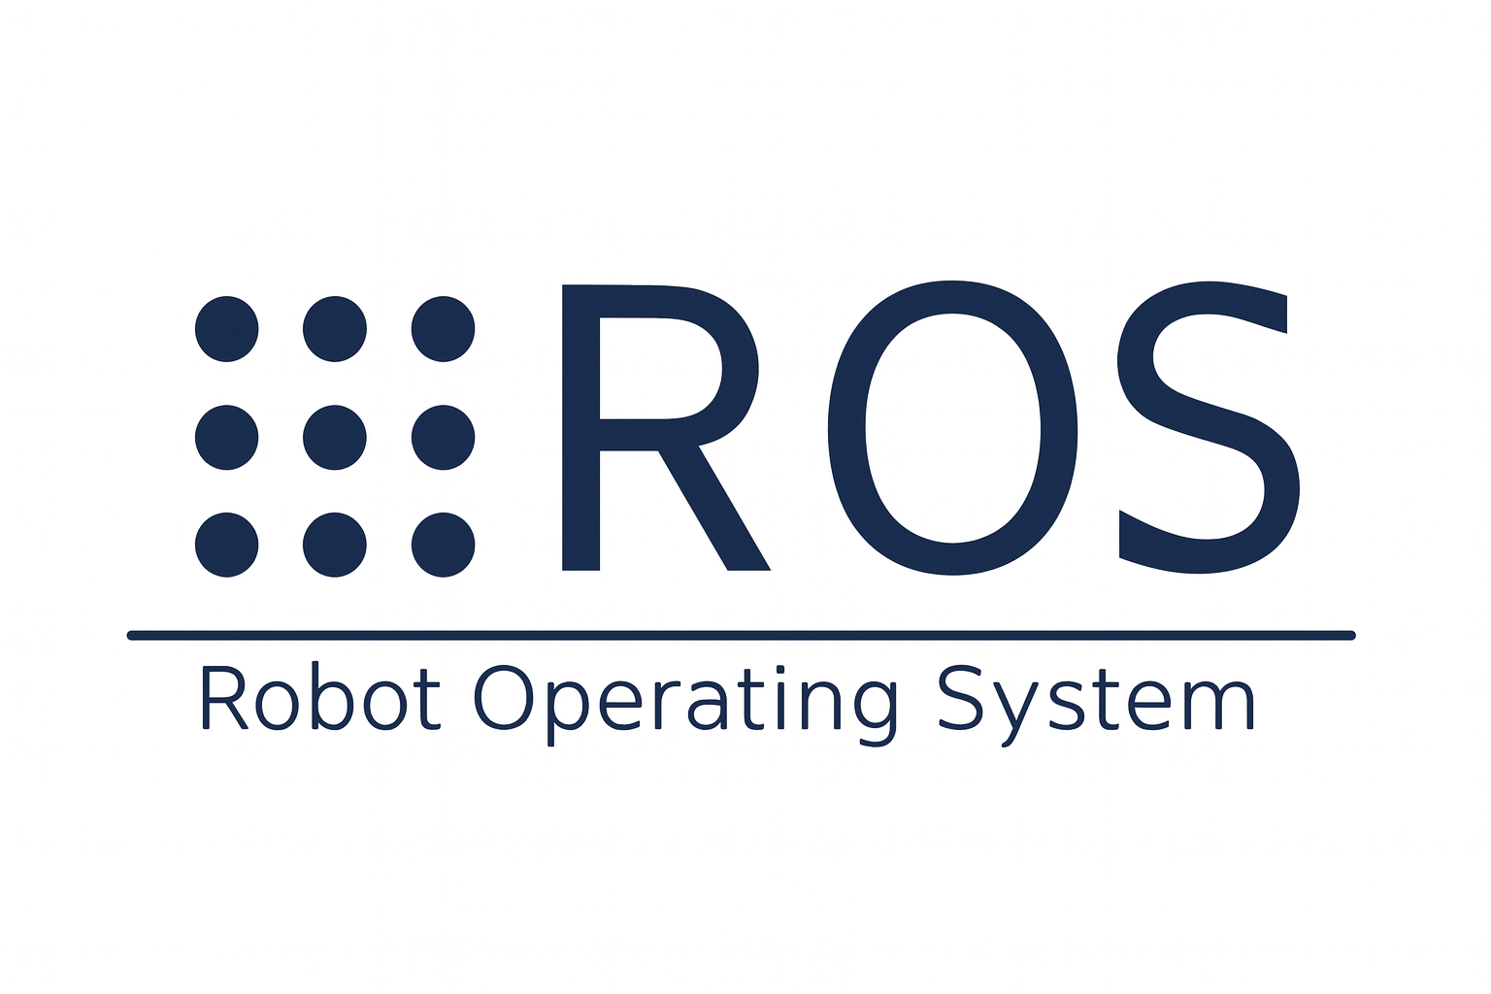

Introduction To
ROS MoveIt

Slide 2
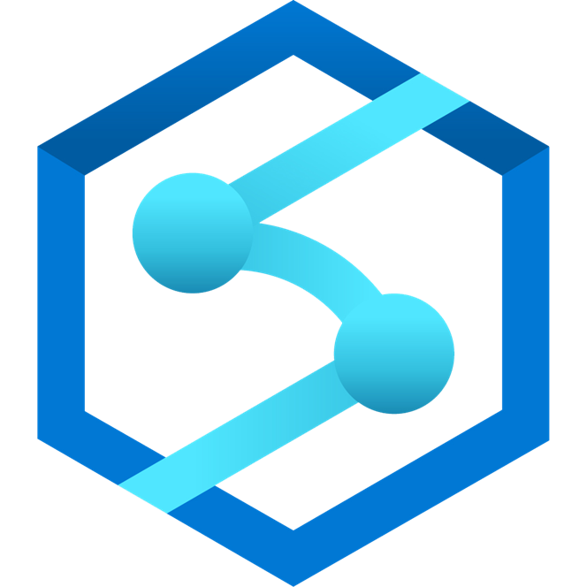
Using ROS MoveIt & Navigation Stack

Slide 3


What is
MoveIt is a motion planning, manipulation, and kinematics framework for ROS, ideal for students and university researchers.
MoveIt is an open-source project that is the result of the combined efforts of a large international community and multiple organizations.
MoveIt has been used on over 150+ robots by the community.
https://moveit.ai/robots/

Slide 4
Why MoveIt?
MoveIt is the most widely used software for manipulation and has been used on over 150 robots.
It is released under the terms of the BSD license, and thus free for industrial, commercial, and research use.
By incorporating the latest advances in motion planning, manipulation, 3D perception, kinematics, control and navigation, MoveIt is state of the art software for mobile manipulation.
Notes:
The BSD license is a family of permissive free software licenses that place very few limits on how people can use, change, and share code. The main rules are that you must keep the copyright notice, the list of conditions, and the disclaimer of duty

Slide 5
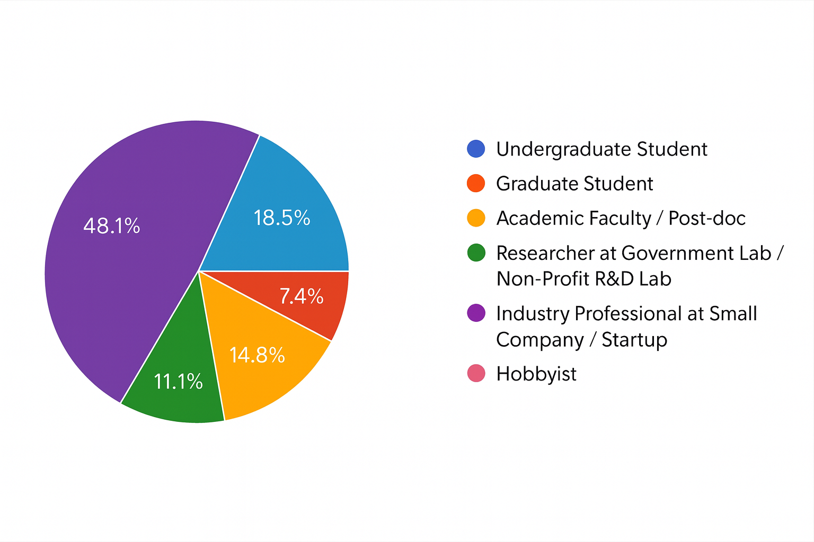
MoveIt Survey in 2019

Slide 6


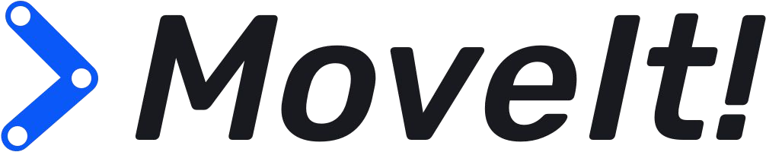
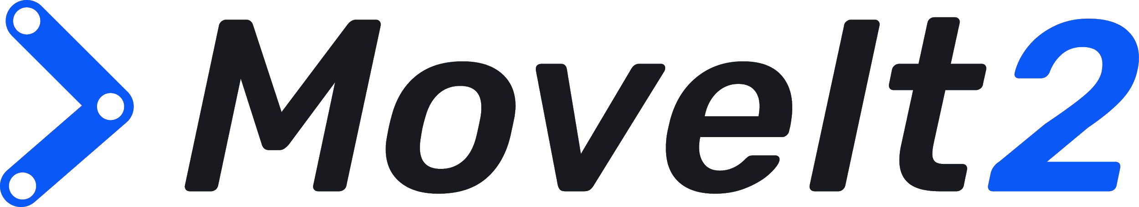
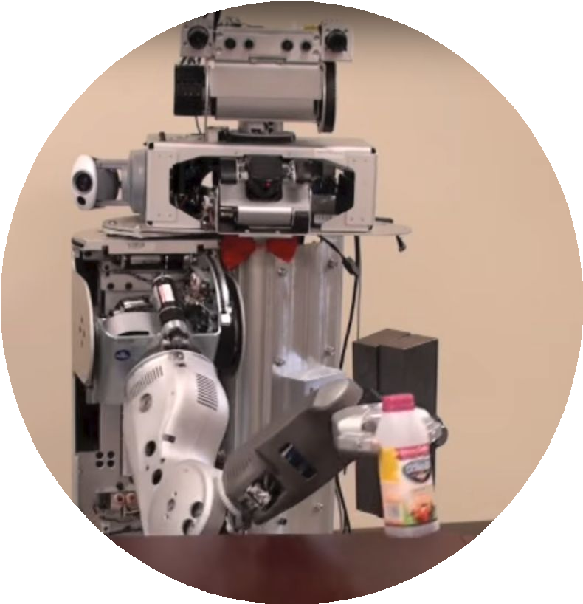
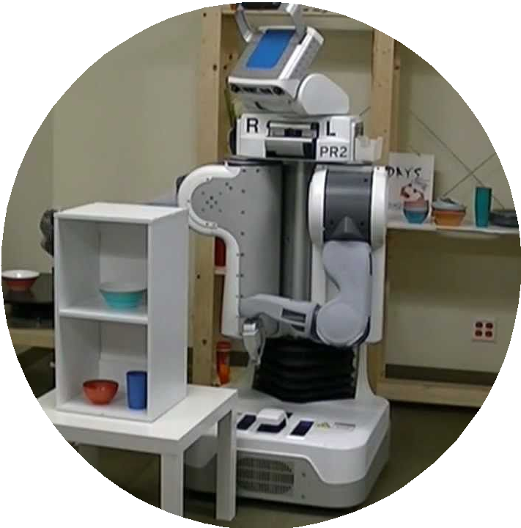
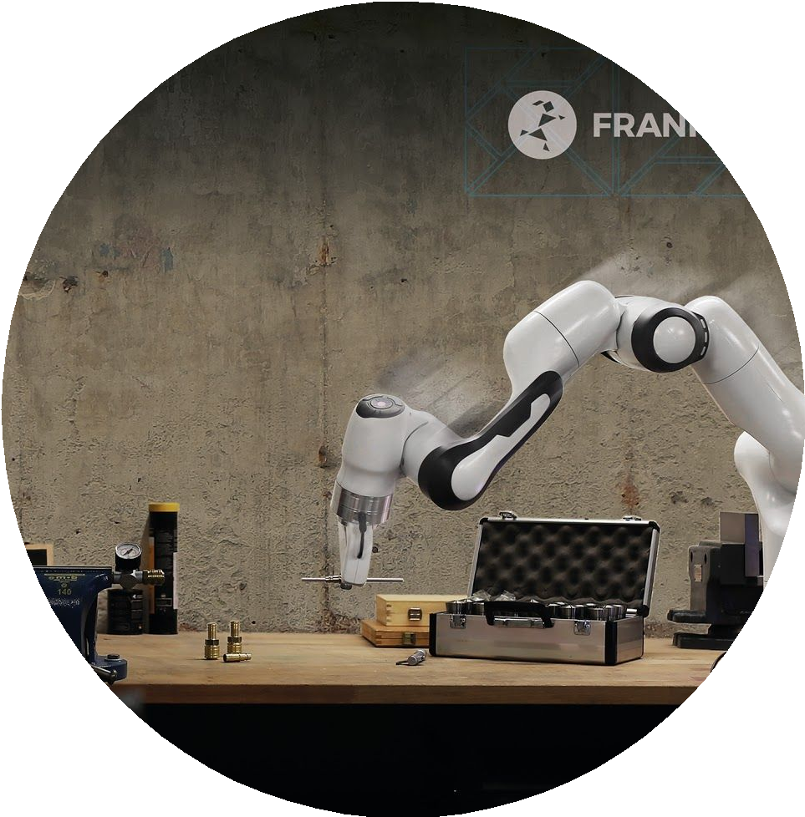
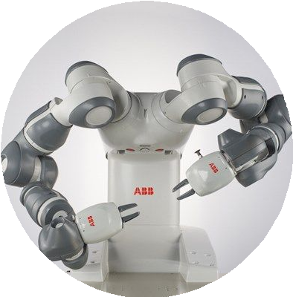
MoveIt: Evolution of a Motion Planning Platform
Version 1.0
2010
Beta
2013
Version 1.0
2019
Version 2.0
2020

Slide 7
MoveIt 1 vs MoveIt 2
MoveIt 1 | MoveIt 2
Runs on ROS 1 | Runs on ROS 2
Limited real-time support | Better real-time behavior via ROS 2 (DDS, QoS)
Older, less modular architecture | Component-based, more modular and scalable
Mostly single-threaded in practice | Designed for multi-threaded use with component nodes
Uses older ROS control stack | Integrates with ROS 2 Control for cleaner hardware interfaces
Limited support for parallel planning | Supports parallel planning pipelines (multiple planners in parallel)
Mature but based on legacy ROS 1 ecosystem | Actively developed, future-focused in ROS 2 ecosystem
Good for existing ROS 1 deployments | Recommended for new projects and modern applications

Slide 8
Functionalities of MoveIt
1. Motion Planning
  Generate high-degree of freedom trajectories through cluttered environments and avoid local minimums
2. Manipulation
  Analyze and interact with your environment with grasp generation
Notes:
Grasp generation is the computational process of calculating stable 3-dimensional positions and orientations (poses) for a robot hand or gripper to securely hold an object. Key methodologies include Diffusion Models, Variational Autoencoders, and Vision-Language Models.

Slide 9
Functionalities of MoveIt
3. Inverse Kinematics
  Solve for joint positions for a given pose, even in over-actuated arms
4. Control
  Execute time-parameterized joint trajectories to low level hardware controllers through common interfaces

Slide 10
Functionalities of MoveIt
5. 3D Perception
  Connect to depth sensors and point clouds with Octomaps
6. Collision Checking
  Avoid obstacles using geometric primitives, meshes, or point cloud data
Notes:
OctoMap is an efficient 3D occupancy grid mapping framework based on octrees, featuring a full 3D model, continuous probabilistic updates, and compact memory usage. It is widely used in mobile robotics and drone navigation to track occupied, free, and unknown areas.

Slide 11
What are the Research Libraries in MoveIt?
OMPL – Open Motion Planning Library for sampling-based motion planning.
SBPL – Search-Based Planning Library for grid and graph search planners.
CHOMP – Covariant Hamiltonian Optimization-based trajectory optimizer.
STOMP – Stochastic Trajectory Optimization for motion planning.
FCL – Fast Collision Checking Library for collision detection.
PCD – Proximity Collision Detection library for distance and collision queries.
IKFast – Analytical inverse kinematics solver that generates closed-form IK.
KDL – Kinematics and Dynamics Library for numerical IK and robot kinematics.
OctoMap – 3D occupancy grid mapping library for representing environments.

Slide 12
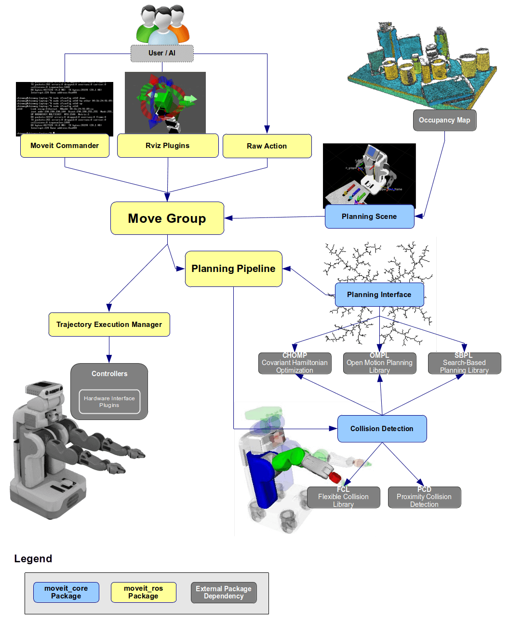
Moveit System Architecture

Slide 13
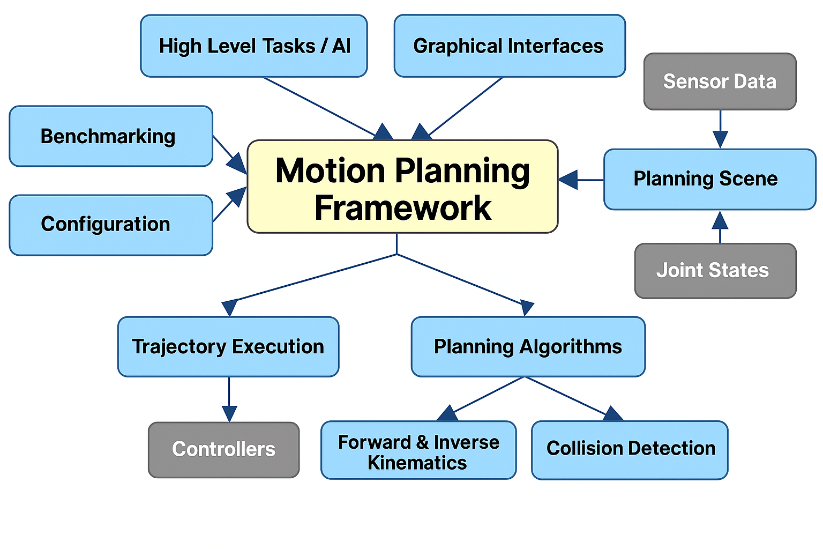
Motion Planning Framework Architecture of MoveIt

Slide 14
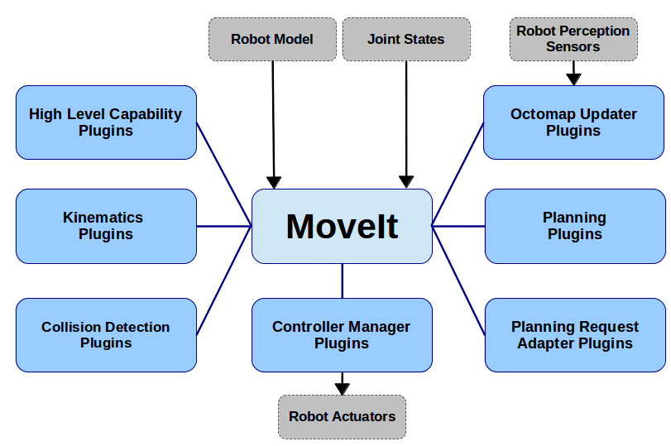
MoveIt Plugin Ecosystem

Slide 15
MoveIt Architecture with Global and Local Planners in ROS 2
Component Node
(Thread)
User Application
MoveItCpp
Core MoveIt functionality
Global Planner
OMPL,TrajOpt...
Component Node
(Thread)
Local Planner
IK,Jacobian,Pilz..
ROS 2 Control
Component Node
(Thread)

Slide 16
Global vs Local Planners
  Global planners find the big path; Local planners fine-tune the small movements.
Global Planner | Local Planner
Plans the entire path from start to goal | Makes small, short-term adjustments along the path
Works on a global map or full planning scene | Works on local, near-by robot motion
Good for long-distance, obstacle-aware planning | Good for precise movements and real-time corrections
Examples: OMPL, TrajOpt, STOMP, CHOMP | Examples: IK solvers, Jacobian-based control, Pilz planner
Slower but produces complete trajectories | Faster, used for real-time or fine control
Handles complex environments | Handles fine positioning or servoing
Used before execution | Used during execution to stay smooth and safe

Slide 17
How the Parallel Planning Architecture in MoveIt 2 Works
MoveIt 2 introduces a system where multiple motion planning algorithms run at the same time on the same planning problem.
This approach increases reliability and helps choose the best possible trajectory for the robot.

Slide 18
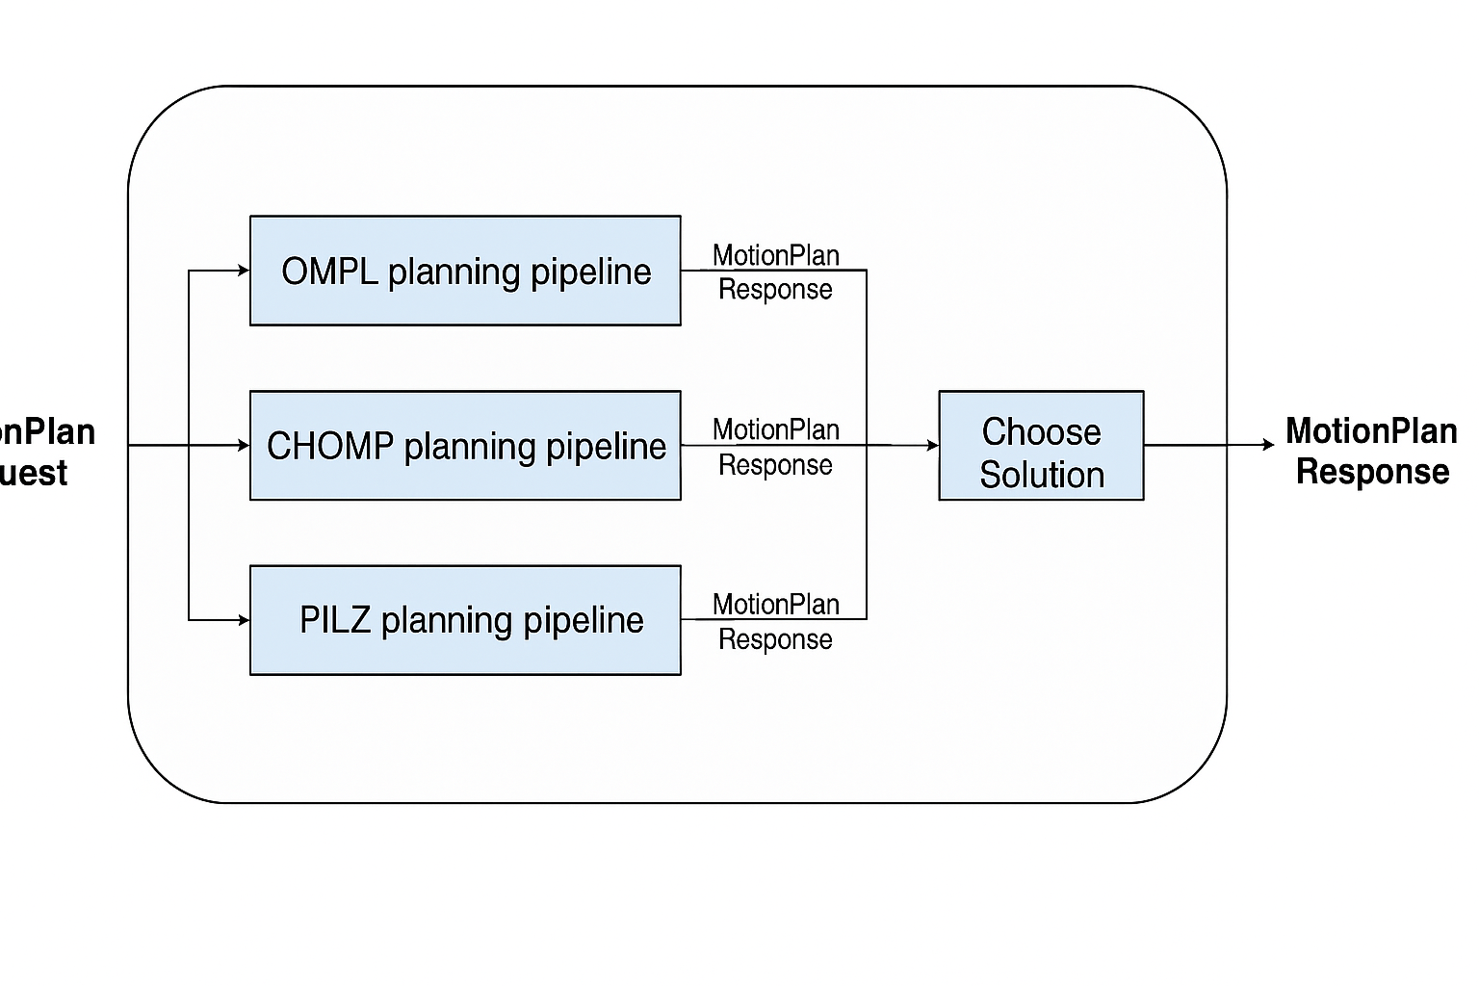
How the Parallel Planning Architecture in MoveIt 2 Works
MotionPlan
Request

Slide 19
How the Parallel Planning Architecture in MoveIt 2 Works
1. Starts With a MotionPlan Request
A MotionPlan Request describes what the robot needs to do:
    The start position
    The goal position
    ObstaclesJoint limits
    Other planning constraints
This single request is sent in parallel to several planning pipelines.

Slide 20
How the Parallel Planning Architecture in MoveIt 2 Works
2. Multiple Planners Run in Parallel
Different planning pipelines try to solve the request at the same time. In the diagram, three planners are shown:
OMPL (Open Motion Planning Library) Planning Pipeline
    Uses sampling-based planners.
    Good for quickly finding feasible paths.
CHOMP (Covariant Hamiltonian Optimization for Motion Planning) Planning Pipeline
    Uses optimization-based methods.
    Produces smooth and refined trajectories.

Slide 21
How the Parallel Planning Architecture in MoveIt 2 Works
2. Multiple Planners Run in Parallel
PILZ (Named after Pilz GmbH & Co. KG) Planning Pipeline
    Used for industrial-style motions.
    Very predictable and deterministic.
Each planner works independently, using its own algorithmic approach.

Slide 22
How the Parallel Planning Architecture in MoveIt 2 Works
3. Each Planner Produces a MotionPlan Response
Each pipeline outputs a MotionPlan Response, which contains:
    A trajectory
    Whether planning succeeded
    Planning time
    Path quality metrics
So, after running, we have multiple candidate solutions to the same problem.

Slide 23
How the Parallel Planning Architecture in MoveIt 2 Works
4. The “Choose Solution” Step Selects the Best Path
MoveIt 2 provides a solution selection callback, which is a user-defined function.
This function compares all the planners’ responses and selects the best one according to chosen criteria, such as:
    Shortest path
    Smoothest trajectory
    Fastest planning time
    Safest (maximum clearance from obstacles)
    Lowest overall cost

Slide 24
How the Parallel Planning Architecture in MoveIt 2 Works
5. Final Output: A Single MotionPlan Response
After the best trajectory is selected, it becomes the final MotionPlan Response returned to the user or to the robot’s controller for execution.

Slide 25
Grasping using Deep Learning
MoveIt now supports robust grasp pose generation using deep learning.
Pick and place robots equipped with a depth camera and either a parallel jaw or suction gripper can increase productivity when paired with deep learning.
The MoveIt Task Constructor provides an interface for any grasp pose generation algorithm making MoveIt’s pick and place capabilities more flexible and powerful.
Currently, the Grasp Pose Detection (GPD) library and Dex-Net are being used to detect 6-DOF grasp poses given 3D sensor data.

Slide 26
Grasping using Deep Learning

Slide 27
Advanced Applications of Moveit
Complex Task Sequencing for Material Handling

Slide 28
Advanced Applications of Moveit
ML (Machine Learning)-Powered Bin Picking

Slide 29
Advanced Applications of Moveit
Whole Body Cartesian Planning

Slide 30
Advanced Applications of Moveit
Two robot arms, Robotic grippers
Assembly tasks with Python examples for synchronous and simultaneous motions
Team O2AC – World Robot Summit 2020

Slide 31
Advanced Applications of Moveit
Three-arm robot work cell
Parametrized motions, custom assembly generator using MoveIt
Team O2AS – World Robot Summit 2018

Slide 32
Advanced Applications of Moveit
Two robot arms playing with a diabolo using sticks and string
Uses MoveIt and bio_ik, includes simulation and visualization
Diabolo Play (it is a juggling or circus prop consisting of an axle and two cups, played with a string attached to two hand sticks)

Slide 33
Land, Sea, Air with MoveIt!

Slide 34
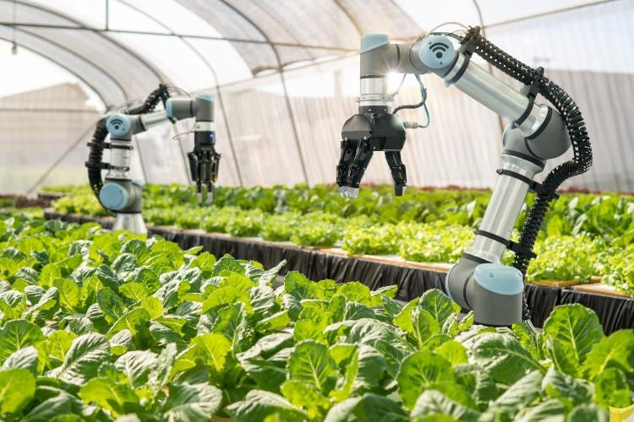
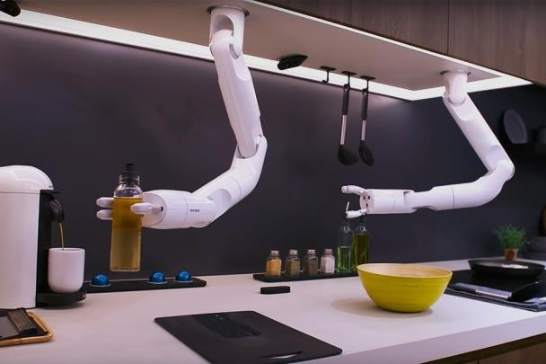
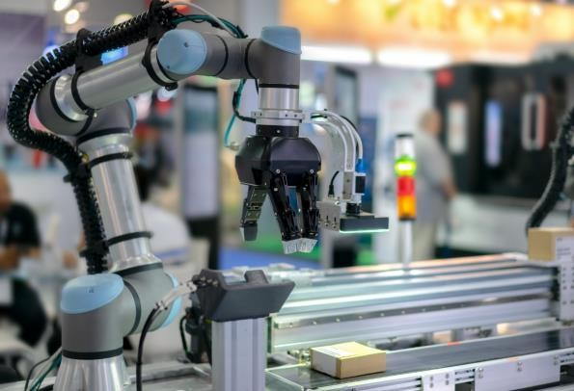
Land with MoveIt!
Agriculture
Plant Harvesting
Food
Kitchen Assistant
Logistics
Bin Picking

Slide 35
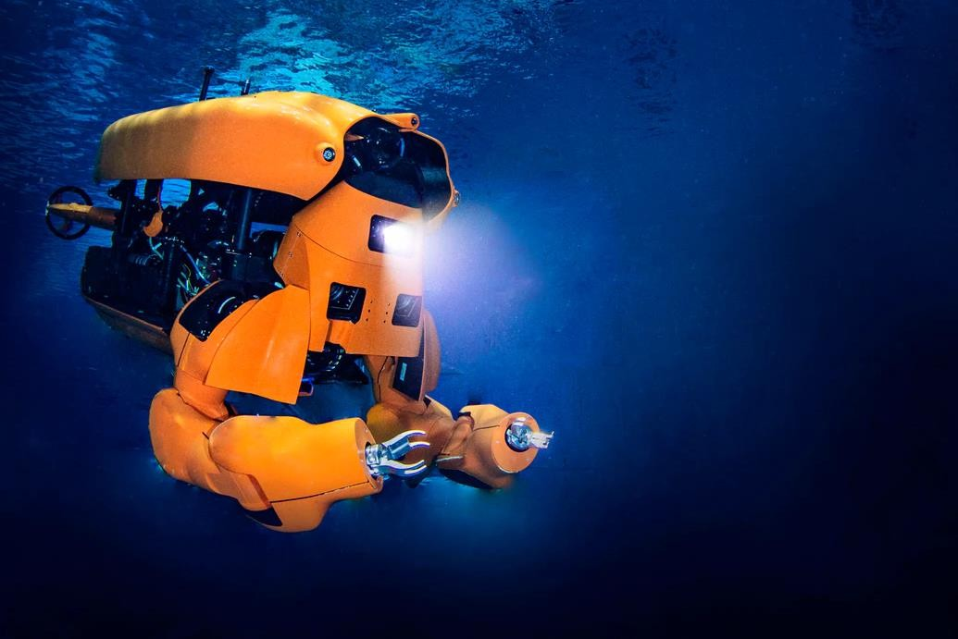
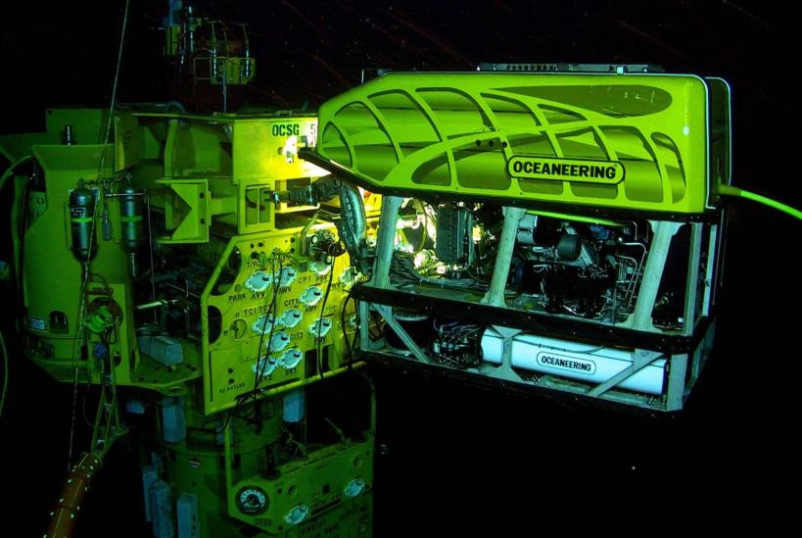
Sea with MoveIt!
Subsea
Remotely Operated
Underwater Vehicles (ROVs)

Slide 36
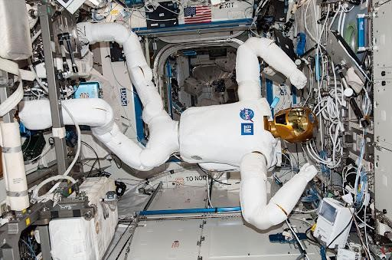
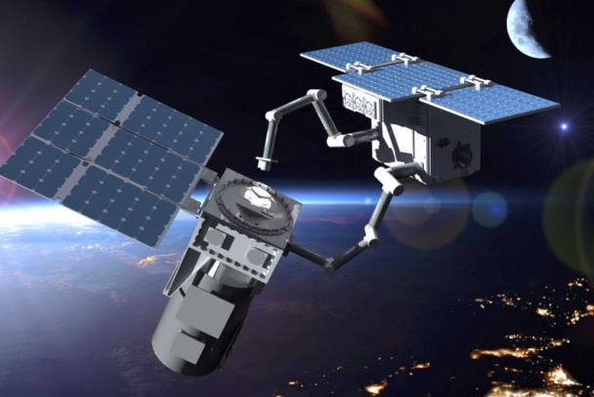
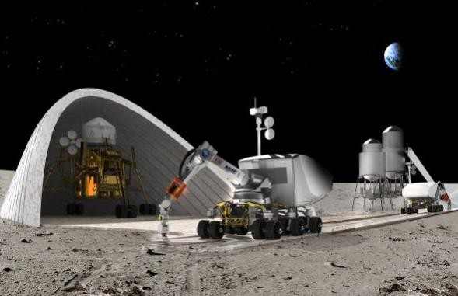
Air with MoveIt!
Space
Inter Vehicle
Robotics
Space
In Orbit Satellite Servicing
Space
Lunar Base Construction

Slide 37
ROS2 Grasp Library
Q: What is the ROS2 Grasp Library, and how does it enable deep-learning-based grasp detection and integration with MoveIt for industrial robot manipulation?
The ROS2 Grasp Library is a ROS 2 package that brings state-of-the-art, CNN-based deep learning grasp detection to industrial robot manipulation, allowing robots to automatically identify good grasp poses from visual data such as depth images. It provides ROS 2–native interfaces that seamlessly integrate with the MoveIt motion planning framework, enabling detected grasp poses to be used directly for collision-free trajectory planning and execution. Because MoveIt and ROS-Industrial already support a wide range of industrial robot models, the ROS2 Grasp Library allows many existing robots to perform flexible, vision-guided pick-and-place tasks without the need for manually programmed grasp positions, improving adaptability, efficiency, and automation in real-world industrial environments.

Slide 38
Hardware Integration Challenges
Q: What is the “Chicken and Egg” problem in MoveIt’s hardware integration, and why does it slow down the adoption of ROS 2 and MoveIt 2?
The “Chicken and Egg” problem in MoveIt happens because both users and hardware companies depend on each other to move forward, but neither wants to go first. Many users want to use ROS 2 and MoveIt 2, but they hesitate because their robot arms, sensors, or grippers don’t yet have full ROS 2 or MoveIt support. At the same time, hardware manufacturers wait for proof that many users actually need ROS 2 support before they spend time and money developing new drivers and interfaces. As a result, users don’t switch because hardware isn’t ready, and hardware doesn’t improve because users haven’t switched. This loop slows down the overall adoption of MoveIt 2 in real robots, even though the software is ready and powerful.

Slide 39
ROS2 Grasp Library
ROS2 Grasp Library

Slide 40
What is TracIK?
TracIK is an alternative Inverse Kinematics (IK) solver designed to outperform the standard inverse Jacobian–based methods found in KDL (Kinematics and Dynamics Library).
It uses smarter search and optimization methods to quickly find joint angles that put the robot’s end-effector (hand/tool) at the desired position and orientation, without breaking any joint limits.
This makes TracIK more reliable and practical for real robots, where joints cannot rotate freely forever and the robot still needs a fast, good IK solution.

Slide 41
What is REACH?
REACH is a tool that helps you check which parts of a large object—like the airplane in the image—a robot can physically reach. It does this by testing many different points on the surface and marking them with arrows.
Points the robot can reach are shown clearly, while unreachable points are marked differently.
This gives you a quick visual map of where the robot arm can or cannot work. REACH is useful for planning tasks like inspection, cleaning, painting, or maintenance because it shows whether the robot’s position, size, or configuration is suitable for the job.

Slide 42
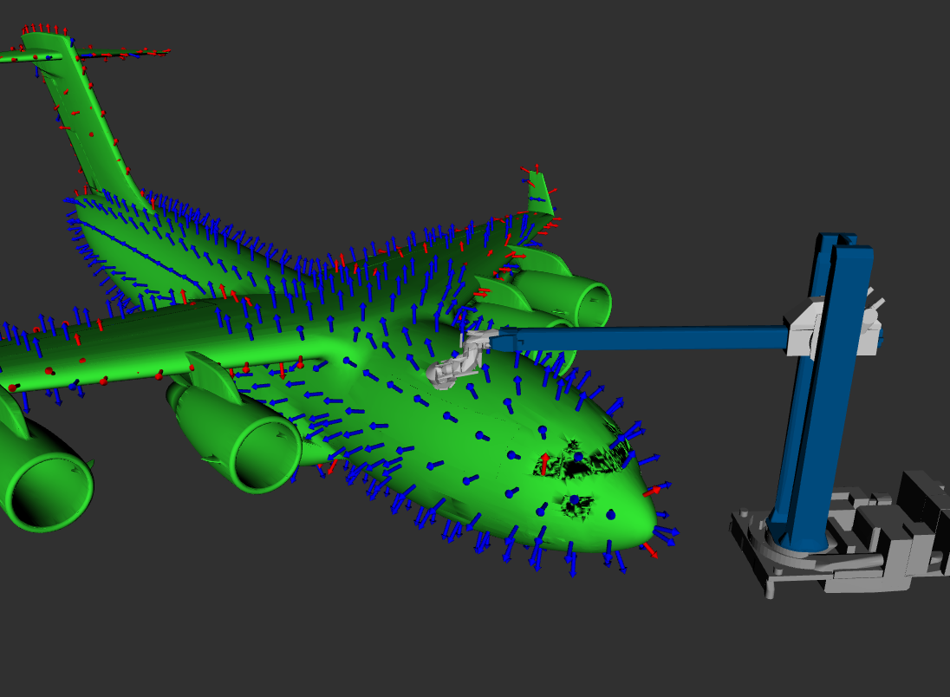
What is REACH?

Slide 43
What is Pilz Industrial Motion?
Pilz Industrial Motion is a tool that makes it simple to create Cartesian motions for industrial robots using MoveIt.
While most robots in ROS already support basic motion planning through RViz and MoveIt, those tools mainly focus on free-space motion.
Pilz adds an easier way to plan straight-line (LIN), point-to-point (PTP), and circular (CIRC) paths in Cartesian space, which are commonly used in factories for tasks like welding, painting, and inspection.
It provides a clean MoveIt interface so users can plan and run these motions without dealing with complex math.
It also lets you blend several motions together smoothly, so the robot can perform a series of moves without stopping between them.
This makes industrial-style robot programming easier, safer, and more predictable.

Slide 44
What is MoveIt Grasps?
MoveIt Grasps is a simple tool that helps a robot figure out how to pick up basic shapes like boxes and cylinders using MoveIt’s pick-and-place pipeline.
It does not worry about advanced physics like friction; instead, it just uses geometry.
You give it the pose of the object (where it is and how it’s oriented), and it automatically creates many possible ways the gripper could approach and grasp the object.
Then it runs inverse kinematics (IK) checks in the background to remove any grasps the robot arm cannot actually reach or perform.
The result is a list of realistic, collision-free grasp options the robot can try.

Slide 45
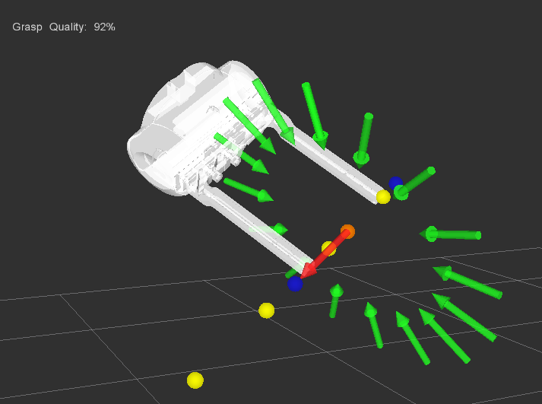
What is MoveIt Grasps?

Slide 46
RViz vs MoveIt
RViz | MoveIt
A 3D visualization tool in ROS | A motion planning and manipulation framework
Shows the robot, sensors, maps, and trajectories | Computes collision-free paths and robot motions
Used to view what the robot is doing | Used to plan how the robot should move
Cannot generate motion plans | Generates motion plans using IK, planners, and controllers
Helps users interact with and inspect the robot visually | Helps robots perform tasks like grasping, picking, placing, and trajectory execution
Mainly for simulation and debugging | Used for both simulation and real robot execution
Displays results from MoveIt | Sends planned motions to RViz for display

Slide 47
MoveIt vs ROS 2
MoveIt | ROS 2
A motion planning and manipulation framework | A robot operating system (middleware layer)
Handles tasks like IK, collision checking, trajectory planning, and manipulation | Handles communication between nodes (topics, services, actions)
Provides high-level robotics capabilities | Provides the foundational tools robots need to run (DDS, nodes, QoS)
Works on top of ROS 2 | MoveIt depends on ROS 2 to communicate and operate
Focused on arm robots, pick-and-place, and planning | Supports all types of robots: arms, drones, mobile robots, sensors, etc.
Includes planners, kinematics solvers, and perception integration | Includes communication, package management, execution, and real-time support
Helps robots decide how to move | Helps robotics software components talk to each other

Slide 48
Advantages of MoveIt with ROS 2
1. Real-time capability
  ROS 2 uses DDS, which supports real-time communication.
  This lets MoveIt perform faster and more predictable motion planning, especially in dynamic environments.
2. Better performance and responsiveness
    MoveIt on ROS 2 benefits from:
    Lower latency
    Multi-threading
    Improved scheduling
  This means smoother and more responsive robot motions.

Slide 49
Advantages of MoveIt with ROS 2
3. Safer and more reliable robot operation
  ROS 2 provides:
      Stronger QoS (Quality of Service)
      Reliable message delivery
      Safer node communication
  This makes MoveIt more robust for industrial and commercial robots.

Slide 50
Advantages of MoveIt with ROS 2
4. Modern software design
  ROS 2 brings:
      Node lifecycle management
      Components/composable nodes
      Cleaner APIs
  This allows MoveIt to be modular, scalable, and easier to integrate into complex robotic systems.

Slide 51
Advantages of MoveIt with ROS 2
5. Improved multi-robot support
  ROS 2 handles multi-robot communication much better than ROS 1.
  MoveIt on ROS 2 can plan for:
      Multiple arms
      Mobile manipulators
      Coordinated robots
  more efficiently.

Slide 52
Advantages of MoveIt with ROS 2
6. Enhanced sensor integration
  ROS 2 improves data handling from:
      Cameras
      Depth sensors
      LiDAR3D perception systems
  MoveIt can therefore build more accurate planning scenes and adapt to changes quickly.

Slide 53
Advantages of MoveIt with ROS 2
7. Real-time obstacle avoidance and servoing
  ROS 1 is no longer being actively expanded.
  ROS 2 is the future of the ROS ecosystem, so MoveIt on ROS 2 ensures:
      Long-term updates
      Better compatibility
      Active community support

Slide 54
Advantages of MoveIt with ROS 2
8. Long-term support and future-proofing
  Features like MoveIt Servo run better on ROS 2, enabling:
      Real-time IK
      Reactive collision avoidance
      Teleoperation
      Fine manipulation

Slide 55
Advantages of MoveIt with ROS 2
9. Commercial readiness
  ROS 2 + MoveIt powers many industrial products (e.g., MoveIt Pro).The combination is more suitable for:
      Factories
      Warehouses
      Field robotics
      Commercial deployments

Slide 56
Advantages of MoveIt with ROS 2
10. Better integration with modern hardware
  ROS 2 supports:
      Real-time controllers
      Modern middleware
      High-speed networking
  MoveIt can thus interface with new robot arms and sensors much more effectively.

Slide 57
Limitations of MoveIt
1. Not fully real-time by itself
  MoveIt is mainly designed for high-level planning, not hard real-time control.
  It cannot guarantee strict timing for every robot controller loop.
2. Computationally expensive for complex robots
  Planning for:
      high-DOF arms
      mobile manipulators
      Humanoids
  can be slow, especially in cluttered environments.

Slide 58
Limitations of MoveIt
3. Depends on external libraries
  Performance and reliability depend on external components like:
      OMPL
      FCL
      IK solvers
  If these struggle, MoveIt may struggle too.
4. Limited support for dynamic obstacles
  MoveIt handles static scenes well, but moving obstacles or fast-changing environments can reduce planning reliability.

Slide 59
Limitations of MoveIt
5. No built-in perception stack
  MoveIt can use sensor data but does not include:
      image processing
      object detection
      grasp pose prediction
  These must be added separately.

Slide 60
Limitations of MoveIt
6. IK solvers may fail in difficult configurations
  Default solvers (like KDL) may fail in:
      Singularities
      joint limits
      complex kinematic chains
  Alternative solvers (TracIK, bio_ik) help, but are not perfect.

Slide 61
Limitations of MoveIt
7. Smoothing and timing are not always optimal
  Generated trajectories might require:
      extra smoothing
      re-timing
      post-processing
  to meet industrial motion quality.

Slide 62
Limitations of MoveIt
8. Hard for beginners to configure
  Creating a MoveIt configuration package involves many steps:
      URDF
      SRDF
      Planning groups
      Controllers
  New users may find this overwhelming.
9. Complex debugging
  Because MoveIt uses many plugins and layers, debugging failures (IK fail, controller fail, collision issues) can be difficult.

Slide 63
Limitations of MoveIt
10. Not ideal for very fast, reactive tasks
  Tasks like:
      high-speed pick-and-place
      real-time balancing
      dynamic manipulation
  may require specialized controllers or servoing systems beyond standard MoveIt planning.

Slide 64
Q & A
?

Slide 65


Thank
you!

